Slide 1
Recitation 1
9/10/21
Greg, Will, & Sheil

Slide 2
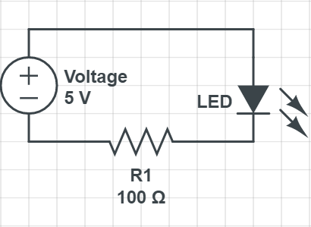
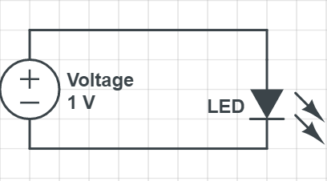
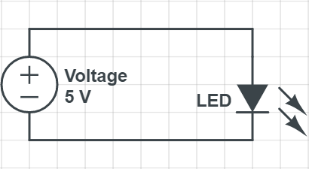
Circuit Design - LEDs
https://www.circuitlab.com/editor/ (CircuitLab Student Edition available through UPenn)

Slide 3
Part Selection
Datasheets, Datasheets, Datasheets
https://digikey.com
Try: white LED
not surface mount
cheapest

Slide 4
Teensy Soldering
https://www.youtube.com/watch?v=XYIqK4uzNYQ
Important: (after you solder)
Use DMM to run connectivity tests between a pin and its neighboring pin(s)
(do this for every pin)

Slide 5
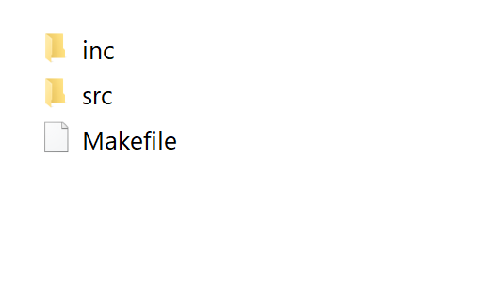
Programming the Teensy
File Structure of your code
Unzip Blinky.zip from Canvas > Files > Resources > Teensy files
inc: header files (.h)
src: source code (.c)
Makefile (instructions for the compiler)
Notes:
WALKER

Slide 6
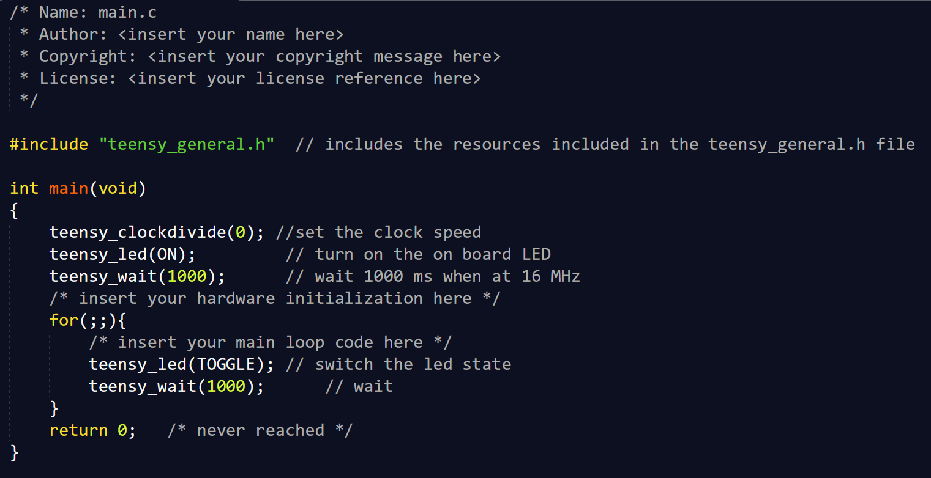
Write C code in your favorite text editor
main.c (inside the “src” folder)
Some text editors:
Sublime
Vim
Emacs
CLion
Notepad++
VSCode
Important: make sure to SAVE your file

Slide 7
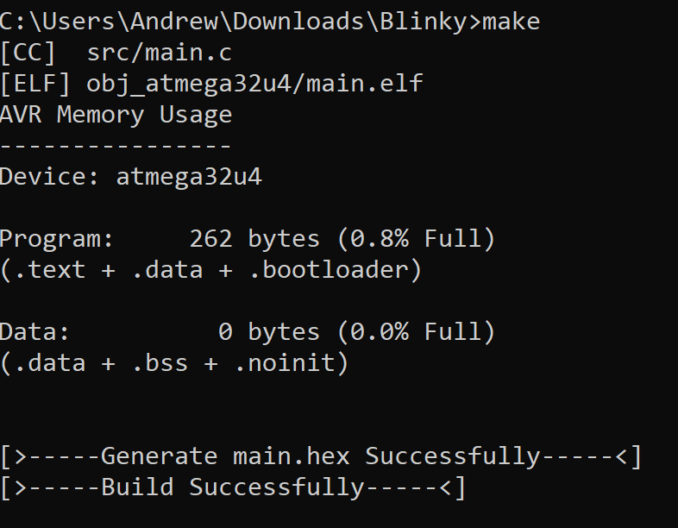
2. Compile and create the .hex file using make
Open up command prompt (Windows) or Terminal (Mac, Linux)
Navigate to your code and execute the make command
There should now be a main.hex file in your folder
Important: you must recompile EVERY TIME you make a change in your main.c

Slide 8
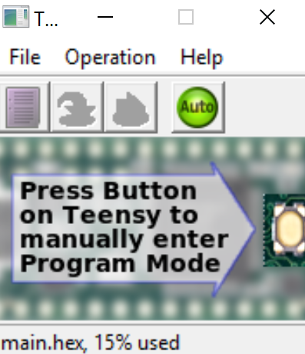
3. Open the .hex file in the Teensy loader
Open the Teensy loader
File > Open HEX File
Press the button on the Teensy (this button also “resets” the Teensy)

Slide 9
Using the command line (optional)
cd directory_name - change directory
ls - list stuff in current directory
touch example.txt - create a file named example.txt
mkdir new_dir - create a new directory named new_dir
Tab key - autocomplete
Up arrow - scroll through command history
Note: commands will work on Mac / Linux (Terminal) or Windows (Powershell)

Slide 10
C Programming

Slide 11
Makefiles
Quick explanation
Smarter way to compile code (though smarter and more complex systems exist)
Only recompile programs whose source code has changed
Reference code from other files without having to manually specify them
No need to modify the Makefile for lab 1

Slide 12
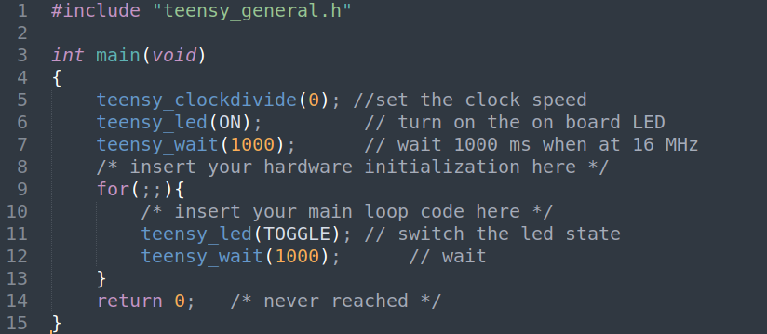
Sample C Program
function/subroutine
Comment, has no effect on the program
Start of the program.
Each program can only have a single main function defined
Return value of the function. 0 means the program exited without error.

Slide 13
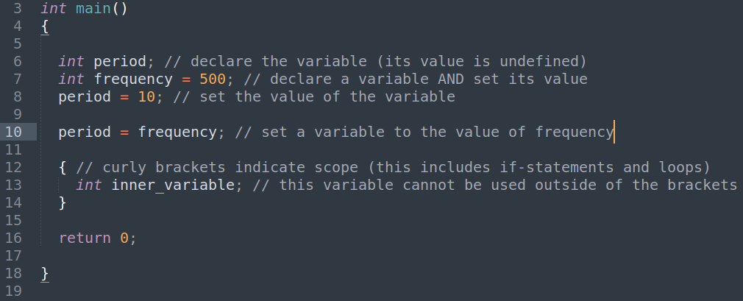
Variables

Slide 14
Datatypes
Data Type | Can represent | Storage size | Range of values
int | Integers | 16 bits (2 bytes) | -(2¹⁵) to 2¹⁵-1
unsigned int | Positive integers | 16 bits (2 bytes) | 0 to 2¹⁶-1
long | Integers | 32 bits (4 bytes) | -(2³¹) to 2³¹-1
unsigned long | Positive integers | 32 bits (4 bytes) | 0 to 2³²-1
float | Decimals (6 decimal places) | 32 bits (4 bytes) | 1.2e⁻³⁸ to 3.4e⁺³⁸
double | Decimals (15 decimal places) | 64 bits (8 bytes) | 2.3e⁻³⁰⁸ to 1.7e⁺³⁰⁸
char | Integers in ASCII encoding | 8 bits (1 byte) | -128 to 127 OR 0 to 255
signed char | Integers in ASCII encoding | 8 bits (1 byte) | -128 to 127
unsigned char | Integers in ASCII encoding | 8 bits (1 byte) | 0 to 255
Notes:
Important LATER

Slide 15
Basic Operations
=
+, -, *
/, %
<, <=, ==, >=, >, != (comparisons)
&, |, ^ , ~, <<, >> (bitwise operations)
In order: and, or, xor, invert/not, shift left, shift right
Operators do different things for different datatypes!
int x = 5/2; → x = 2;
float x = 5.0/2.0 → 2.5;
% means “modulo”, returns the remainder of the division
E.g. 22%5 => 2, 50%2 => 0, 27%4 => 3
! means “not”

Slide 16
Comments! (Pseudocode)
Legible pseudocode is a great way to plan your program
Comments make debugging easier
Is this line of code doing what the comment says it should be doing?
Leaving that pseudocode in your code as comments helps other people (including your current/future self) understand what the code is doing
TAs love well-commented code!

Slide 17
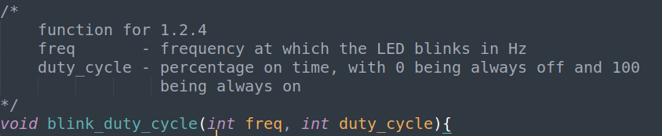
Comments in Code
Line comments:
Comments start from “//” and end at the end of the line
Block comments:
Comments start from “/*” and end at “*/”
Can also “comment out” code that you’re not currently using but want to keep for use in the future.
Notes:
Speaker: Will

Slide 18
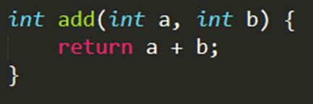
Custom C Functions
Function - a block of code that can be used elsewhere
Helps modularize & organize code
Helps with debugging as well!
How to create and use a function?
Declare the function
Write body
Perform some task on input arguments (copies)
Return a value
Ready for use : Call function with params
Notes:
Speaker: Sheil
Similar to the concept of the main function Will introduced a few slides ago, you are free to build your own custom C functions and we’ll walk you through how to do that.
The purpose of a function is to organize your program into modular building blocks which can be reused throughout the program execution.
A good rule of thumb is: any time you find yourself copy-pasting. Could a function be handling this?
Universally, a custom function you write will have 2 parts: the function declaration, the body (w/ return statement)
Once you create your function, it’s ready to be used somewhere else in your program-- and you can call it with the specified params
Pass by value by default

Slide 19
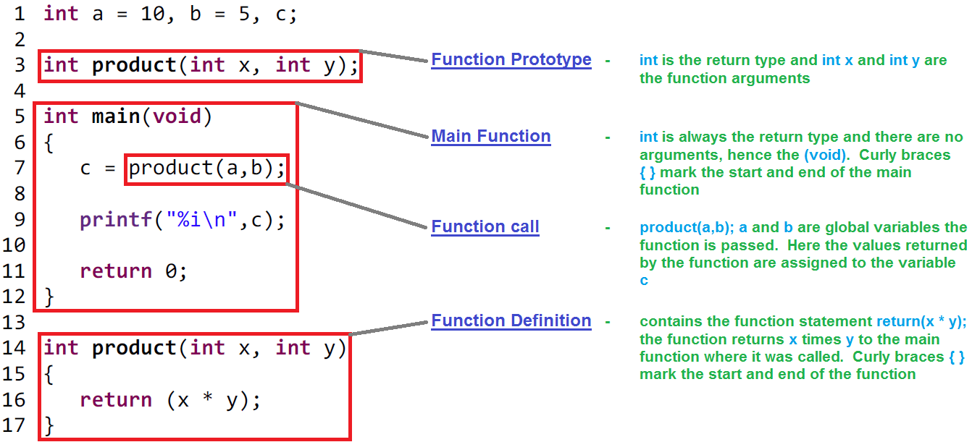
Functions
Notes:
A function has four main components
Return type: int
Name: add
Inputs: a, b
Body: return a + b
Side note: you can skip the function prototype altogether and just define the function before the main function for convenience

Slide 20
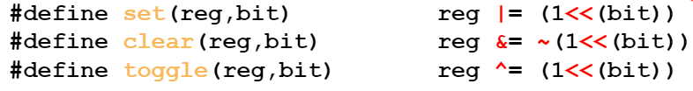
Macros
Start with the #define flag
Great for defining constants or performing bitwise ops (e.g. set / clear / toggle)
NOT meant to be used to execute series of complicated operations -> functions
How it works : compiler substitutes macro with its definition at compile time
Macro name
Arguments
(optional)
Operations performed on arguments
Notes:
Adjacent to functions, you also have macros in C. Both are meant to make your code modular and making code re-usable.
Where macros help most is defining constants, be it what pin you have your LEDs connected to, or what your PWM duty cycle is. That way, if you want to change those values down the road, it’s a one line change instead of a 10 line change.

Slide 21
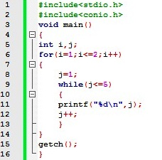
Loops
To repeat a block of code a number of times based on a condition
Types of loops:
For : execute loop body a specified number of times
While : execute loop body if specified condition is true (repeatedly)
Do-while : execute loop body then check if specified condition is true
Example of nested for & while loop ------------>
Notes:
Now we’ll touch on loops, which is it’s own section in the upcoming assignment.
Let’s start with what are loops: loops are a way to repeat code like arithmetic operations, function calls, etc. without copying and pasting the same line over and over
C supports 3 main types of loops, and you can nest them to support your use case
On a high level, what you need to know about each type of loop is:
In the next few slides, we’ll see examples of all of them

Slide 22
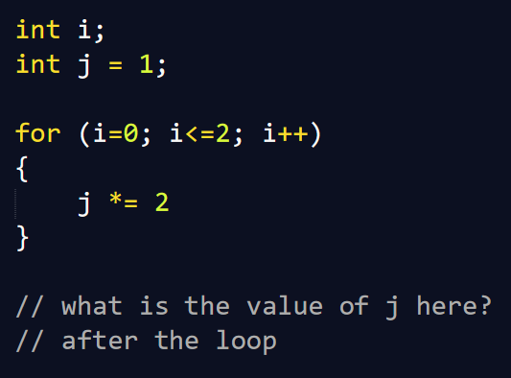
For Loop
Components
Initial condition
Exit condition
Step size (increment/decrement)
Body
Notes:
Value of j after the loop: 2^3= 8 (zero-indexed)

Slide 23
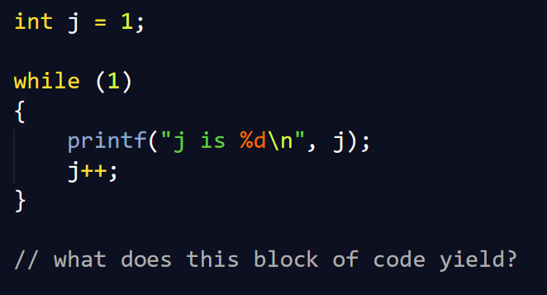
While loop
Components
Condition
Body
Notes:
Very important to have inside main, otherwise program exits almost immediately (after 1 run), which might not even be enough time for all the hardware initialization to happen
What is the size of an int? 16bit
Range = - to + 32768; so after overflow, it’s undefined
Signed integer variables do not have wrap-around behavior in C language. Signed integer overflow during arithmetic computations produces undefined

Slide 24
Arrays
“null” terminator
type name[size]
char greeting[6] = “Hello”;
int sequence[5] = {1,1,2,3,5};
Accessing an element of an array: name[index]
int x = sequence[2]; // assigns the value at index 2 of sequence to x
sequence[3] = 500; // places a value of 500 inside the sequence array at index 3
index | 0 | 1 | 2 | 3 | 4 | 5
value | H | e | l | l | o | \0
index | 0 | 1 | 2 | 3 | 4
value | 1 | 1 | 2 | 3 | 5
Notes:
Note - no “strings”
Zero Indexed (NOT like MATLAB)
Careful accessing values outside of your array (may not throw an error) : undefined behaviour

Slide 25
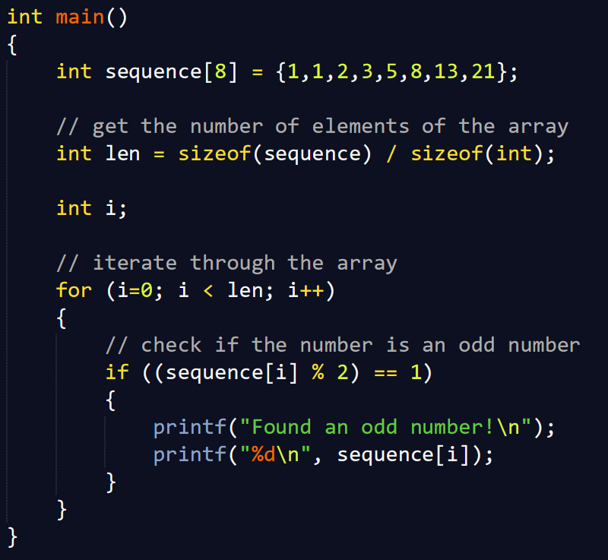
Arrays
int sequence[8] = {1, 1, 2, 3, 5, 8, 13, 21};
Write a loop that iterates through the array and prints all the odd numbers
Initial condition
Exit condition
Step size (increment/decrement)
Body

Slide 26
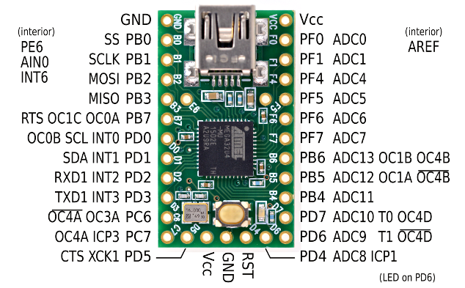
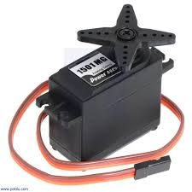
I/O Ports
What they are and how to use them?
GPIO - General Purpose Input/Output
DON’T FRY YOUR BOARD:
20mA per pin
100mA per port
200mA for the whole board
SG90 Servo Current (typical during movement) | 100-250mA
Great reference for Teensy pinout: http://medesign.seas.upenn.edu/index.php/Guides/Teensy-pins

Slide 27
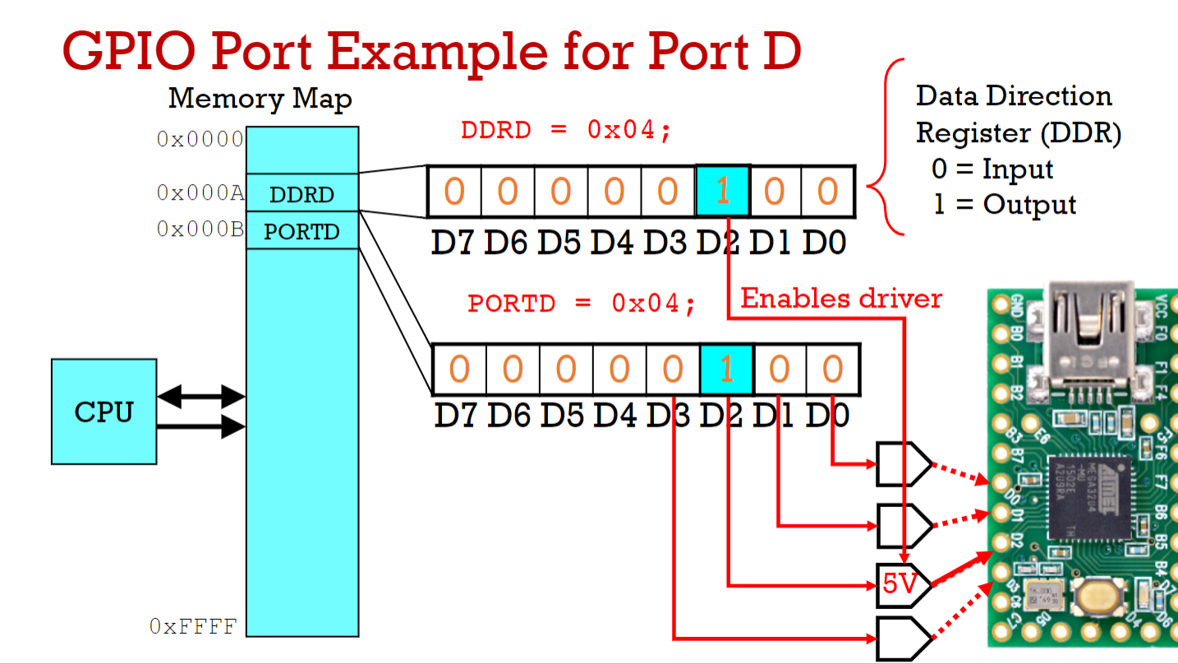
Registers
Will be covered in-depth next week in Lecture 3
Register = Location in memory
Control Registers you will use:
Direction Register (DDRx)
Determines whether the pins operate as inputs or outputs
Read/Write
Data Write Register (PORTx)
Maps to state of port (e.g. logic high/ low)
Read/Write
Data Reading Register (PINx)
Read only

Slide 28
How to setup and use I/O Ports
First, set to input or output with DDRx register
"Data Direction Register" - clearing a bit will configure that pin to input, while setting a bit will configure the pin for output
By default, all pins are set to input (cleared) but don’t trust this - reset the DDR before use
In output mode, control pins with PORTx register
Setting a bit drives that pin high
Clearing a bit drives that pin low
In input mode, read pins with PINx register

Slide 29
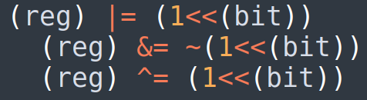
Practice setting registers
What do these bitwise operations do?
(1 << (bit))
|=
&=
^=

Slide 30
Timers
Timer = type of clock (built-in hardware clock)
Runs independently of the CPU
Counts at the Timer clock speed
Components
Timer clock speed (determined by the prescaler)
Timer Mode (how the timer will count)
Counter (the value of the Timer)
Output compare
Input capture
Uses:
To count the time elapsed
To run a function at a specific frequency
Time taken for 1 increment?
1 ÷ timer clock speed

Slide 31
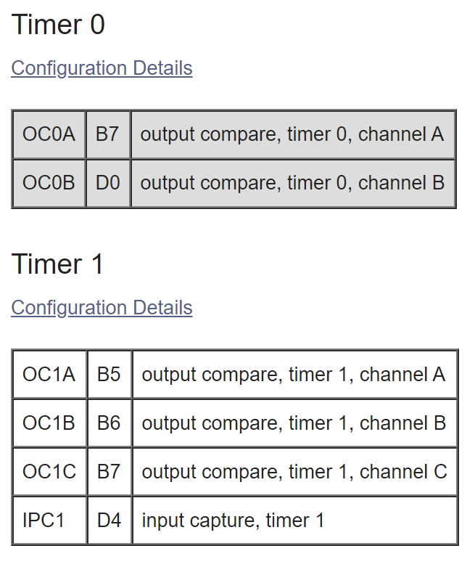
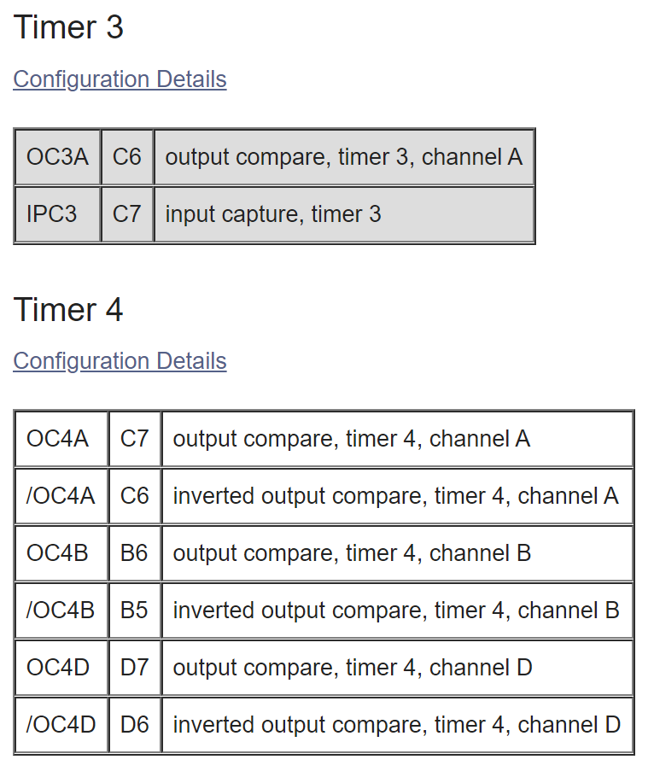
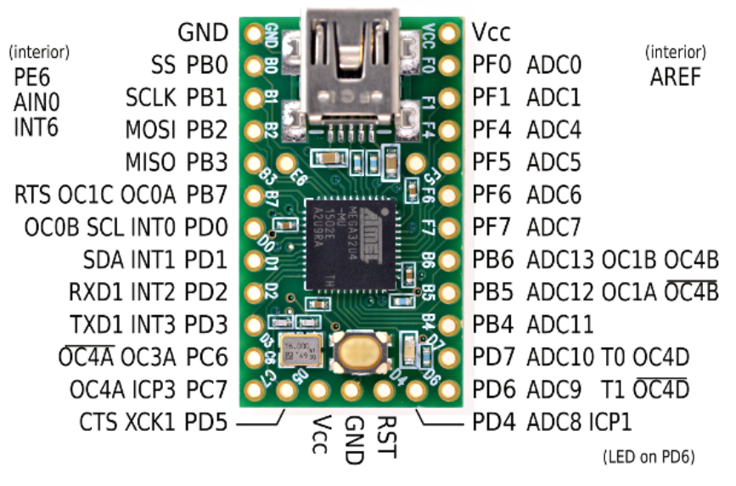
Timers (on the Teensy)
(16 bit)
(8 bit)
(10 bit)
(16 bit)

Slide 32
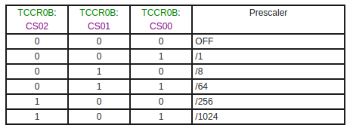
Programming Timers: Prescaler
Timer speed = clock speed ÷ prescaler
Note: prescaling the timer clock DOES NOT affect the system clock
Note: need teensy_clockdivide(0); in your code for the Teensy system clock to be 16MHz

Slide 33
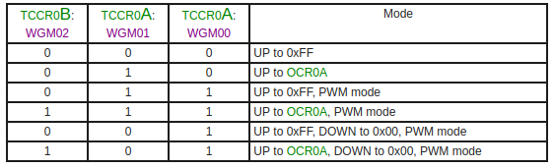
Programming Timers: Timer Modes

Slide 34
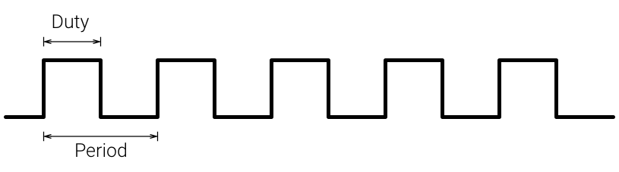
Pulse Width Modulation (PWM)
PWM = a type of digital signal
Uses:
When we only have digital power, but we want analog
Digital means that the signal can only be high or low (nothing in between)
Use cases: LED brightness, servo motors, DC motors
The digital signal can only be high (usually 5V) or low (0V or GND) at any given time, but we can change the proportion of time the signal is high compared to when it is low over a consistent time interval

Slide 35
Pulse Width Modulation (PWM)
Components
Duty Cycle
Frequency (Period)
Duty Cycle
Usually expressed in a %
Duty cycle% = on time ÷ period
On time = time that the signal is “high”
Frequency (1 ÷ period)
Number of cycles per second

Slide 36
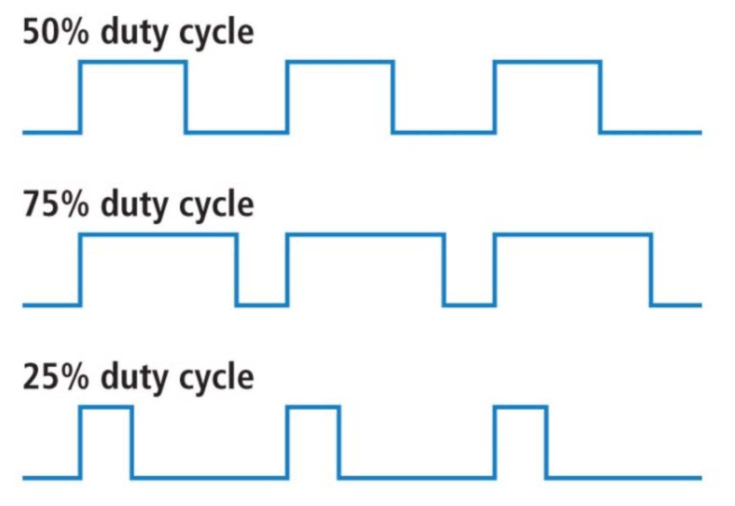
Pulse Width Modulation (PWM)
Duty Cycle
Usually expressed in a %
Duty cycle% = on time ÷ period
On time = time that the signal is “high”

Slide 37
Pulse Width Modulation (PWM)
Choosing a frequency
Frequency is specific to the application
Examples:
20% duty cycle @ 1 Hz for LED would just blink the LED
20% duty cycle @ 200 Hz for LED would blink the LED too quickly for our eyes to see (dimmed LED)
Higher frequency = lower period = more difficult to distinguish on and off (actual blinking)
Servos need to be updated every 20ms (in general)

Slide 38
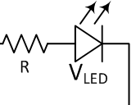
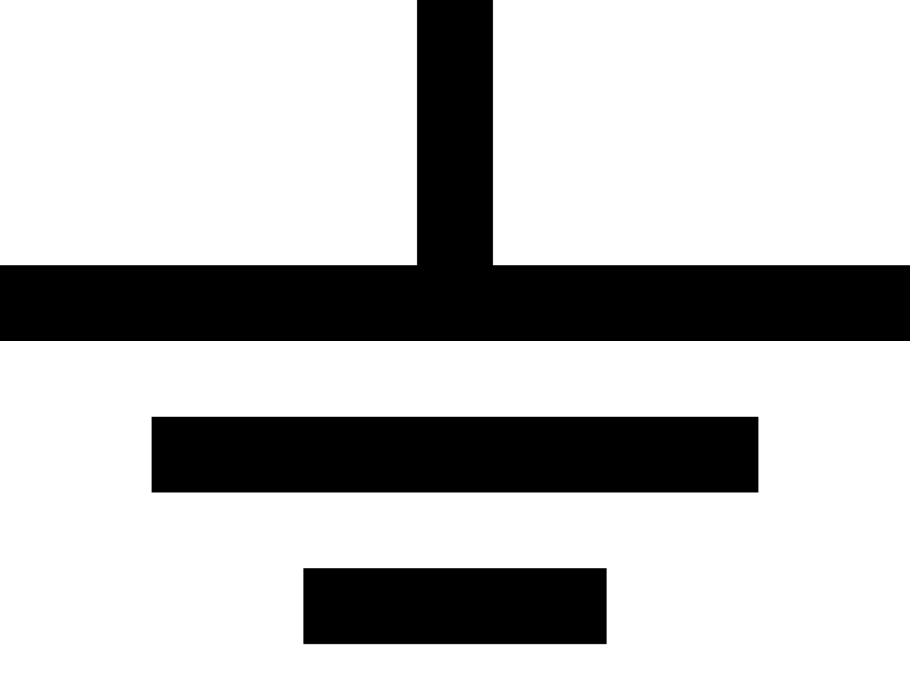
Pulse Width Modulation (PWM)
Dimming an LED:
Blinking an LED too quickly for human eyes to perceive the LED actually turning on or off

Slide 39
PWM without Timers
Use teensy_wait(ms);
Turn pin high, wait, turn pin low, wait, etc. (loop)

Slide 40
PWM without Timers
Using Timers
Potential issues?

Slide 41
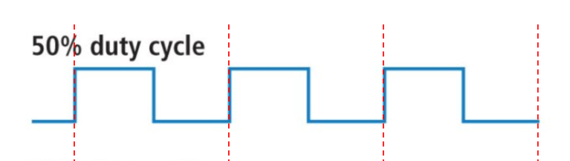
PWM with Timers
How can we use Timers to implement PWM?
Implement 50% PWM duty cycle:

Slide 42
Programming Timers: Reading Timer Value
TCNT0

Slide 43
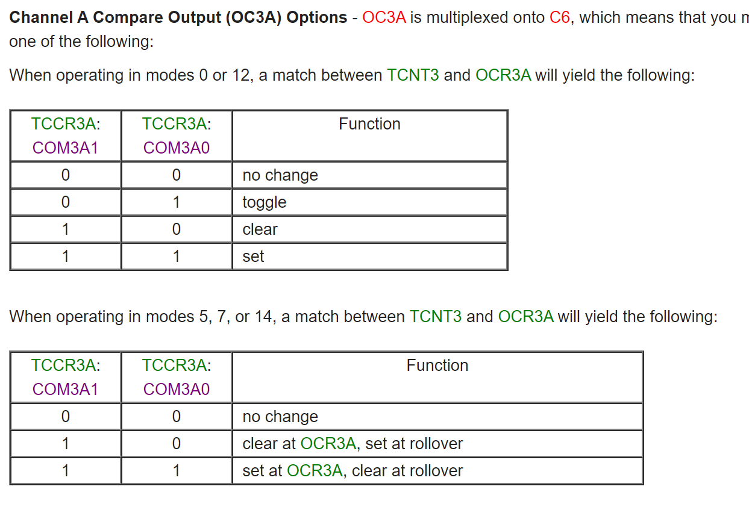
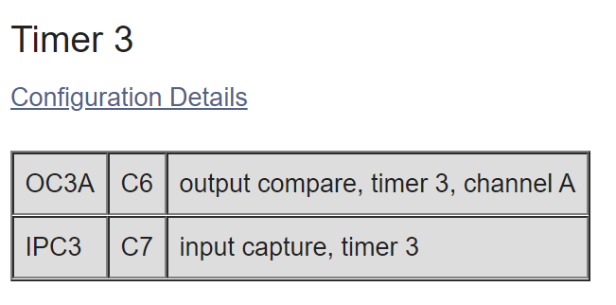
Timers
Output Compare
The pin or pins that get controlled by the Timer

Slide 44
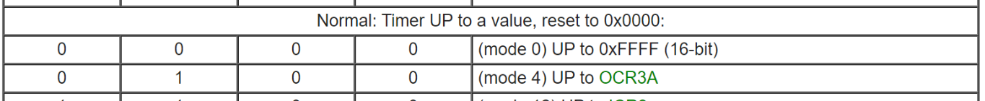
Timers (Example 1)
Draw the graphs of Timer counter + output
+ set pin C6 to 0 at 0xFFFF

Slide 45
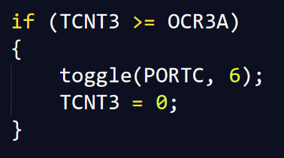
Timers (Example 2)
Draw the graphs of Timer counter + output

Slide 46
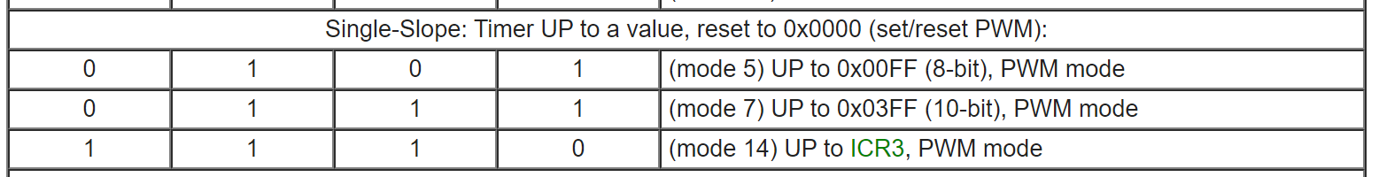
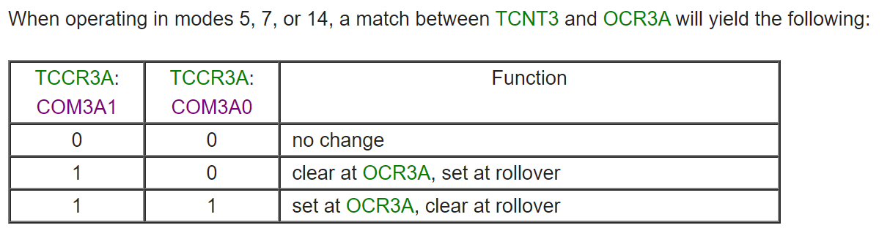
Timers (Example 3)
Draw the graphs of Timer counter + output

Slide 47
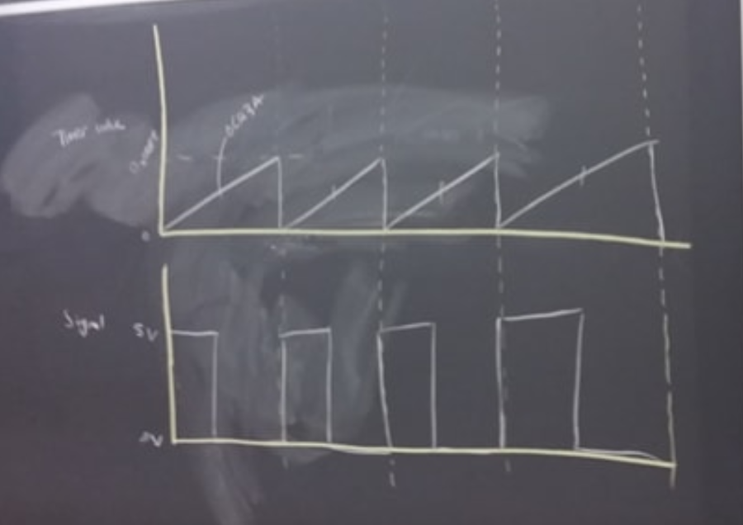
Timers (Example 3: Answer)
OCR3A
Timer counter value
The pin “clears” at OCR3A according to the mode that we’ve set the Timer to (goes to 0V)
The pin “sets” at rollover according to the mode that we’ve set the Timer to (goes to 5V)
Signal at output compare pin OC3A (C6)

Slide 48
Timers
Considerations when choosing a Timer
Output pins (output compare)
Timer clock speed
Size of timer (# of bits, max. counter value)
Input capture

Slide 49
Timers (on the Teensy)
(16 bit)
(8 bit)
(10 bit)
(16 bit)

Slide 50
Pulse Width Modulation (PWM)
PWM = a type of digital signal
Uses:
When we only have digital power, but we want analog
Digital means that the signal can only be high or low (nothing in between)
Use cases: LED brightness, servo motors, DC motors
The digital signal can only be high (usually 5V) or low (0V or GND) at any given time, but we can change the proportion of time the signal is high compared to when it is low over a consistent time interval

Slide 51
Pulse Width Modulation (PWM)
Components
Duty Cycle
Frequency (Period)
Duty Cycle
Usually expressed in a %
Duty cycle% = on time ÷ period
On time = time that the signal is “high”
Frequency (1 ÷ period)
Number of cycles per second

Slide 52
Pulse Width Modulation (PWM)
Duty Cycle
Usually expressed in a %
Duty cycle% = on time ÷ period
On time = time that the signal is “high”

Slide 53
Pulse Width Modulation (PWM)
Choosing a frequency
Frequency is specific to the application
Examples:
20% duty cycle @ 1 Hz for LED would just blink the LED
20% duty cycle @ 200 Hz for LED would blink the LED too quickly for our eyes to see (dimmed LED)
Higher frequency = lower period = more difficult to distinguish on and off (actual blinking)
Servos need to be updated every 20ms (in general)

Slide 54
Pulse Width Modulation (PWM)
Dimming an LED:
Blinking an LED too quickly for human eyes to perceive the LED actually turning on or off

Slide 55
PWM without Timers
Use teensy_wait(ms);
Turn pin high, wait, turn pin low, wait, etc. (loop)

Slide 56
PWM without Timers
Using Timers
Potential issues?

Slide 57
PWM with Timers
How can we use Timers to implement PWM?
Implement 50% PWM duty cycle:

Slide 58
PWM with Timers (Answer)
Also see Timers (Example 3) for graphs
There are multiple ways to achieve PWM with Timers, this is one method.
Duty cycle?
OCR3A ÷ 0x00FF

Slide 59
PWM with Timers
How can we adjust the duty cycle? → changing OCR3A

Slide 60
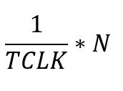
PWM with Timers
How long does it take for each cycle of the PWM to run?
Depends on the Timer clock and the value that the Timer is counting up to
Let TCLK be the Timer clock in Hz, and N be the value that the Timer counts up to before resetting
Answer: Time taken for 1 period of PWM: [Units: s]

Slide 61
Programming the Teensy
File Structure of your code
Unzip Blinky.zip from Canvas > Files > Resources > Teensy files
inc: header files (.h)
src: source code (.c)
Makefile (instructions for the compiler)

Slide 62
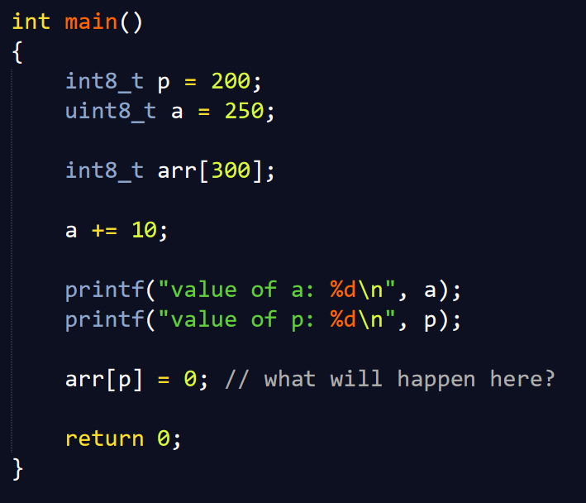
Overflow

Slide 63
